Slide 1
Compression Algorithms
By : Jamar Thomas Jr

Slide 2
Overview
Deifinition
Huffman Coding
Arithmetic coding
Big O – Notation
Test Questions

Slide 3
What are compression algorithms?
Compression Algorithms are a technique used in computer science to reduce the size of a file without removing information. It achieves this by finding a formula that describes the data and produces compressed data that appears more random.
Notes:
https://www.sciencedirect.com/topics/computer-science/compression-algorithm

Slide 4
Huffman Coding
An entropy-coding method that builds a variable length code for symbols based upon frequencies
These are used in image compression such as JPEG & DEFLATE
ZIP, PNG
Notes:
https://www.sciencedirect.com/topics/computer-science/compression-algorithm

Slide 5
Huffman Coding – alphabet Example (Greedy Algorithm)
Symbol | Frequency
A | 5
B | 9
C | 12
D | 13
E | 16
F | 45
Notes:
https://www.sciencedirect.com/topics/computer-science/compression-algorithm

Slide 6
Huffman Coding – alphabet Example (Greedy Algorithm)
Heap: [A(5), B(9), C(12), D(13), E(16), F(45)]
Step 1
Node1(14)
/ \
A(5) B(9)
Step 2
Node2(25)
/ \
C(12) D(13)
Step 4
Node4(55)
/ \
Node2(25) Node3(30)
/ \ / \
C(12) D(13) Node1(14) E(16)
/ \
A(5) B(9)
Step 3
Node3(30)
/ \
Node1(14) E(16)
/ \
A(5) B(9)
Notes:
https://www.sciencedirect.com/topics/computer-science/compression-algorithm

Slide 7
Huffman Coding – alphabet Example (Greedy Algorithm)
Final Tree
Binary Code Table
Root(100)
/ \
F(45) Node4(55)
/ \
Node2(25) Node3(30)
/ \ / \
C(12) D(13) Node1(14) E(16)
/ \
A(5) B(9)
Symbol | Code
F | 0
C | 100
D | 101
A | 1100
B | 1101
E | 111
“ABCD” Encoded = 11001101100101
Notes:
https://www.sciencedirect.com/topics/computer-science/compression-algorithm

Slide 8
Huffman Coding – Pros & Cons
.
Pros
Cons
Efficient for variable-length symbols: Very effective when symbol frequencies are uneven.
Prefix-free codes: No code is a prefix of another → easy decoding.
Simple to implement using greedy algorithms and heaps.
Fast encoding and decoding, especially for static data sets
Not optimal for very small files: Header overhead can outweigh benefits.
Assumes static frequency: If symbol frequencies change during a file, performance drops.
Less efficient than arithmetic coding for fractional probabilities.
Can’t compress certain patterns well (e.g., repetitive strings with even frequencies)
Notes:
https://www.sciencedirect.com/topics/computer-science/compression-algorithm

Slide 9
Arithmetic Coding
1976 through the work of Jorma Risannen and Richard Pasco.
Arithmetic coding relies on the fact that there are an uncountably infinite number
Encodes the full message into one floating point number 0 to 1
More precise than Huffman coding for some distributions
Non-Uniform Distributions; Where powers are not powers of 2
Notes:
https://www.sciencedirect.com/topics/computer-science/compression-algorithm

Slide 10
Arithmetic Coding – Basic Example
Symbol | Probability | Range
A | 0.5 | 0.0 – 0.5
B | 0.3 | 0.5 – 0.8
C | 0.2 | 0.8 – 1.0
Notes:
https://www.sciencedirect.com/topics/computer-science/compression-algorithm

Slide 11
Arithmetic Coding
Range of B is a subrange of A.
Lower Boundary of the range is .25
0.0 + ( 0.5 – 0.0) * 0.5
Upper Boundary of the range is .40
0.0 + ( 0.5 – 0.0) * 0.8
Notes:
https://www.sciencedirect.com/topics/computer-science/compression-algorithm

Slide 12
Arithmetic Coding – Pros & Cons
.
Pros
Cons
High Compression Efficiency
Adapts better to skewed or changing symbol frequencies
Ideal for adaptive compression algorithms
VIDEO & AUDIO
More complex; due to floating/fixed point arithmetic
Slower than Huffman for simple messages
Vulnerable to precision errors
Notes:
https://www.sciencedirect.com/topics/computer-science/compression-algorithm

Slide 13
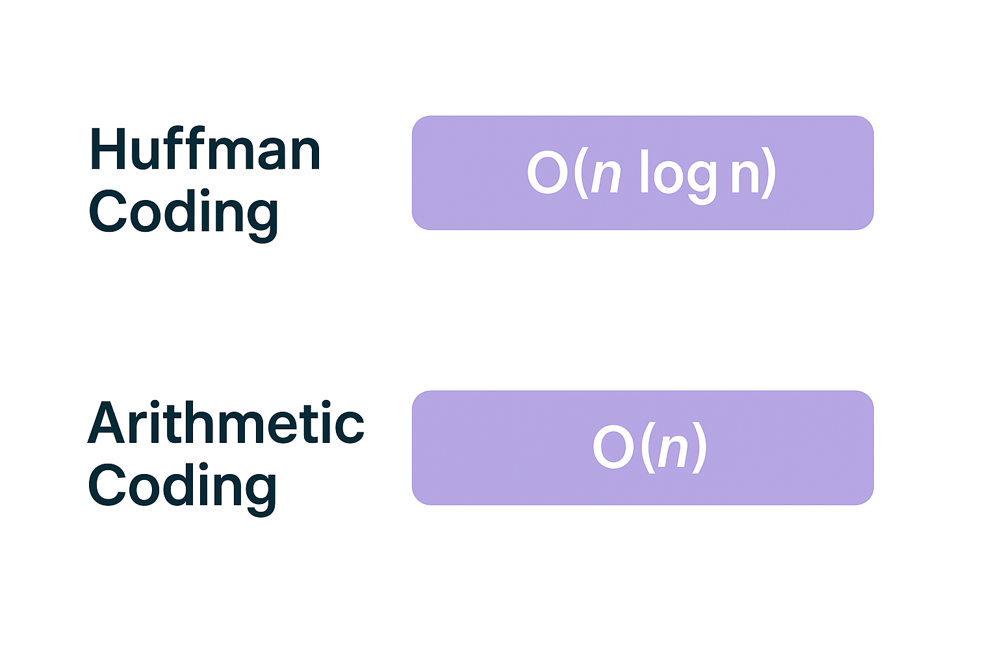
BIG O Notation

Slide 14
Exam Questions
What is a drawback of arithmetic coding? A. It cannot handle text B. It's rarely used in practice C. The math-heavy iterative process can be complex to explain D. It compresses worse than Huffman coding
In which of the following is Huffman coding used? A. GIF B. PNG C. JPEG (first stage) D. MP4
What is a limitation of Huffman coding? A. It works only with images B. It cannot compress data C. It’s not optimal when symbol probabilities vary a lot within a file D. It requires a decompression dictionary
What is a distinguishing feature of arithmetic coding compared to Huffman coding? A. It uses fixed-length codes B. It encodes a message as a single floating-point number C. It builds a dictionary D. It sorts the input alphabet

Slide 15
Exam Questions
What is a drawback of arithmetic coding? A. It cannot handle text B. It's rarely used in practice C. The math-heavy iterative process can be complex to explain D. It compresses worse than Huffman coding
In which of the following is Huffman coding used? A. GIF B. PNG C. JPEG (first stage) D. MP4
What is a limitation of Huffman coding? A. It works only with images B. It cannot compress data C. It’s not optimal when symbol probabilities vary a lot within a file D. It requires a decompression dictionary
What is a distinguishing feature of arithmetic coding compared to Huffman coding? A. It uses fixed-length codes B. It encodes a message as a single floating-point number C. It builds a dictionary D. It sorts the input alphabet

Slide 16
THANK YOU
References
“Compression Algorithm.” Compression Algorithm - an Overview | ScienceDirect Topics, www.sciencedirect.com/topics/computer-science/compression-algorithm
Chatgpt, chatgpt.com

